Slide 1


Capstone Project Review #1

Slide 2
Capstone Project Review #1
Project Title : Early detection of Pulmonary fibrosis with Machine Learning
Project ID : Capstone24; EC20
Project Guide : Prof. Lakshmeesha Sir

Slide 3
Outline
Objective
Introduction
Motivation and Scope of the Project
Literature Survey
Design block diagram and flowchart
Capstone (Phase-II & Phase-III) Project Timeline using gantt chart.
Conclusion
References

Slide 4
ABSTRACT
Fibrosis may refer to the connective tissue deposition that occurs as part of normal healing or to the excess tissue deposition that occurs as a pathological process.
Most chronic inflammatory illnesses include fibrosis as a pathogenic characteristic.
Extracellular matrix (ECM) components build up in excess to cause fibrosis or scarring. T
he fibrotic process finally results in organ malfunction and death if it is severely progressive.
This leads to scarring and thickening of tissues and itaffects nearly all tissues of the body.
Note: Scarring results in the thickening and stiffening of the affected tissue, leading to the disruption of normal structure and function.

Slide 5
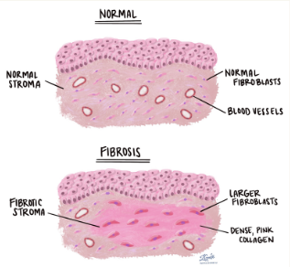
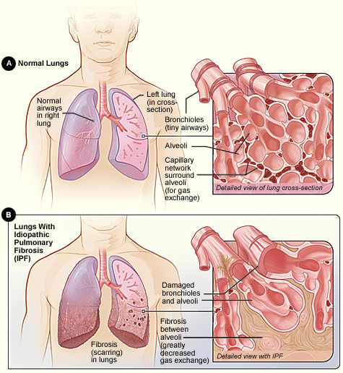
Idiopathic pulmonary fibrosis (IPF) is a serious chronic (long term) disease that affects the tissue surrounding the air sacs, or alveoli, in the lungs
|--> It worsens over time.
Fibrosis & Pulmonary Fibrosis

Slide 6
Fibrosis Begins at the lower lung zone
Symptoms – The dependencies
Shortness of breath – After walking shorter distances
Dry cough – For about months to years
Aching muscles and joints Loss of appetite
Chest discomfort
Tobacco smoking
Connective tissue diseasesDecrease in SPO2
Crepitations - Crepitations in the lungs are crackling or popping sounds that can be heard or felt when breathing
ABG – Tests the amount of O2 & CO2 present -a low oxygen level on an ABG test can suggest significant lung fibrosis is present.
Reticulonodular opacities - Reticulonodular opacities appear as fine, web-like (reticular) structures mixed with small nodules spread throughout the lungs.
Lung texture change due to honeycombing patterns
GGO [Ground glass opacity] - appears as hazy, cloud-like regions where the lung tissue is partially filled with fluid, inflammatory cells, or thickened interstitial tissue.
Early diagnosis and treatment of IPF may increase lifespan and preserve quality of life.

Slide 7
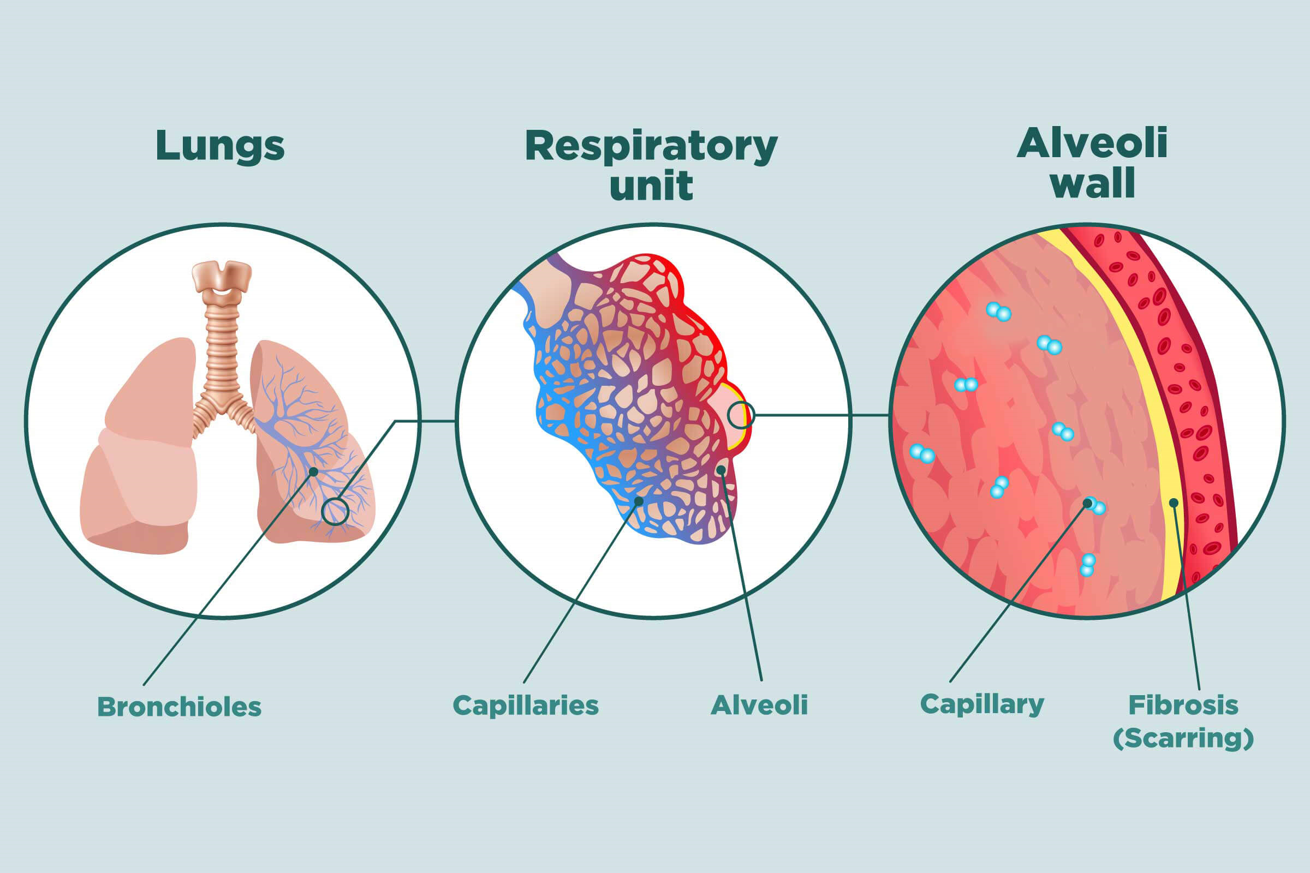

Slide 8
Constraints / Dependencies / Assumptions
Legal Implications Data Privacy & Ethics: The project must comply with HIPAA (Health Insurance Portability and Accountability Act), GDPR (General Data Protection Regulation), and local regulations if patient data is involved.
Usage Limitations
Complementary to Expert Diagnosis: The system should be used as an assistive tool, not as a replacement for radiologists or pulmonologists.
Software Dependencies:
Machine Learning Frameworks: TensorFlow, PyTorch, or Scikit-learn.
Image Processing Libraries: OpenCV, PIL (Python Imaging Library).
Medical Imaging Tools: DICOM libraries (e.g., pydicom) for processing chest X-rays or CT scans.
Development Environment: Jupyter Notebook, Google Colab, or a high-performance computing setup.
Hardware Dependencies: Sound Acquisition: Electronic microphone must be used in order to acquire auscultation

Slide 9
The Model
Stage | Action Performed
Input Acquisition | Accept X-ray, lung sound, and symptoms data from users
Preprocessing | Noise reduction, image enhancement, feature extraction
ML Model Processing | CNN for X-rays, Spectrogram CNN for lung sounds, Decision model for symptoms
Fusion & Risk Prediction | Model combines inputs to determine fibrosis risk level
Output Generation | Visual reports, probability scores, and personalized health recommendations
Security & Compliance | Data encryption

Slide 10
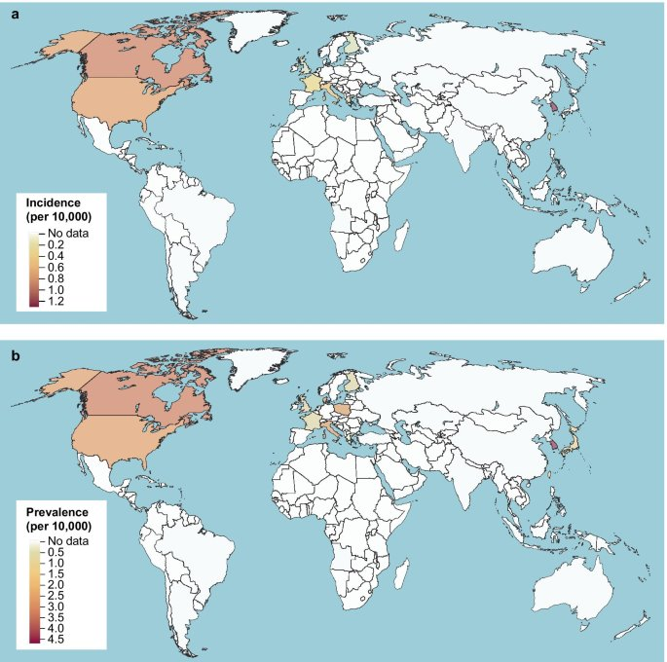
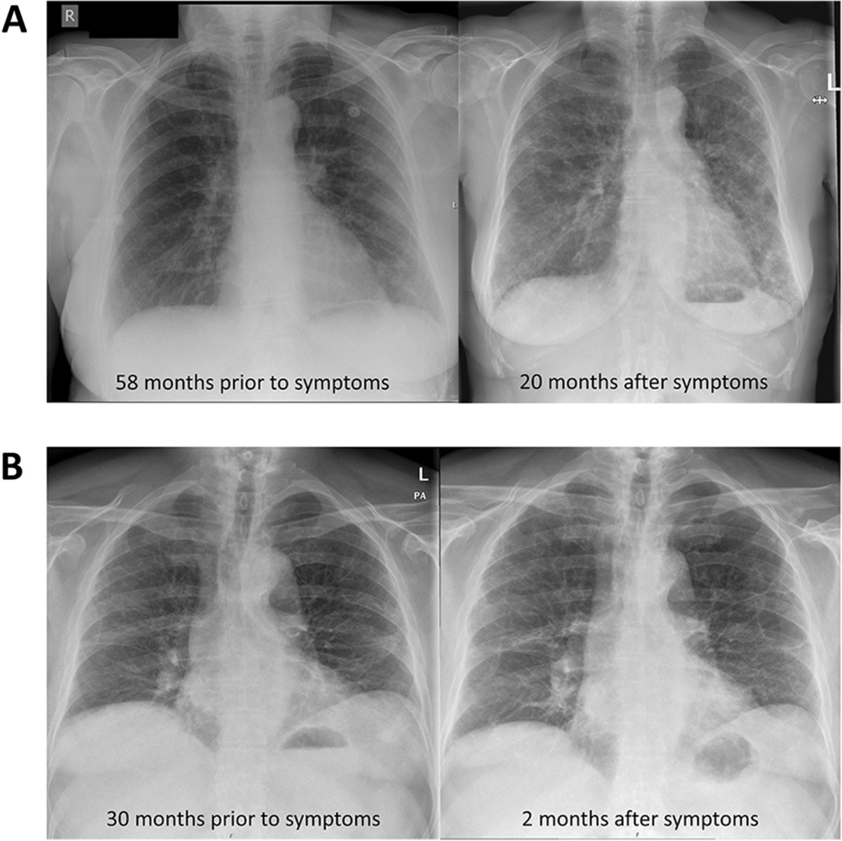
The Distribution

Slide 11
Risks and Existing Technologies
Technology Failure Risks
Model Performance Issues: The ML model may have low accuracy, leading to misdiagnoses.
Overfitting Risk: The model might perform well on the training set but fail on new data due to overfitting.
Data Preprocessing Errors: Poor quality or noisy data can lead to inaccurate model predictions.
Non – Invasive Detections:
High-resolution computed tomography (HRCT) scan
Exhaled breath analysis - Spirometers
Lung auscultation sounds – by Impulse Oscillometer (IOS)
Electromyography
Forced vital capacity - through forceful breathing
Invasive Detections:
Surgical Lung Biopsy (SLB)
Endobronchial Ultrasound (EBUS) with Transbronchial Needle Aspiration
VideoAssisted Thoracoscopic Surgery
Transbronchial Lung Cryobiopsy

Slide 12
Scope and Feasibility study
Challenges in Early Detection:
Late diagnosis due to mild initial symptoms
Limited accessibility to advanced imaging
Need for a non-invasive, AI-driven solution
Project Goal:
Develop a user-specific model that integrates X-ray image analysis, microphone-based lung auscultation, and user symptoms for early lung fibrosis detection.
Acquire lung sounds using a microphone[ 3 on the front, 3 on the back of the lung], ensuring precise auscultation for fibrosis detection.

Slide 13
Challenges & Applications***
Potential Challenges:
Signal Quality and Noise
Model Accuracy
Wearable Device Integration
Real-Time Data Processing
Application and Use Cases:
Early detection of lung fibrosis could expand the life expectancy
Personalized Care
Remote monitoring
Better Assistance to the Doctors
Cost and Time Efficiency
Accurate Results

Slide 14
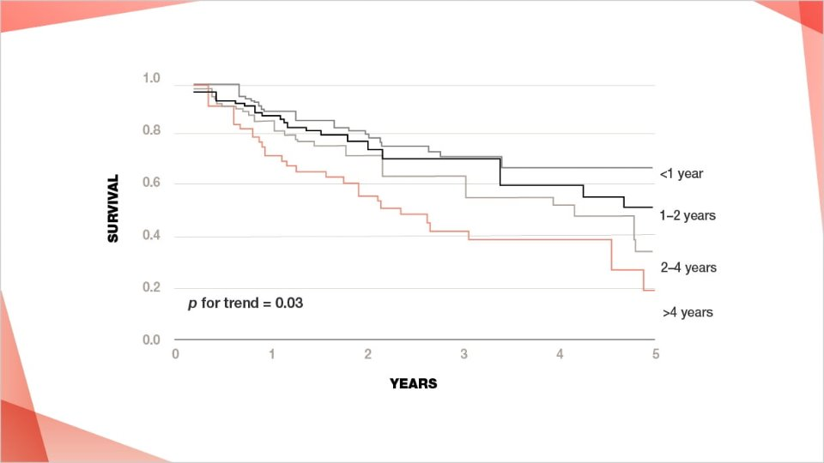
The Model and Causes
Causes of pulmonary fibrosis:
Environmental exposure
Hypersensitivity Pneumonitis
Medications
Radiation
Autoimmune conditions
Genetic factors
Lung fibrosis, including Idiopathic Pulmonary Fibrosis (IPF) and other interstitial lung diseases, is a progressive condition where early detection can significantly influence outcomes.

Slide 15
Expected Deliverables
Capstone-II deliverables
Data Collection & Preprocessing Plan
Technology Stack Setup
Machine Learning Model Development
Capstone-III deliverables
Model Evaluation & Testing
Prototype App Development
Capstone-IV deliverables
Model Optimization & Fine-Tuning
End-to-End System Integration
User Testing & Validation

Slide 16
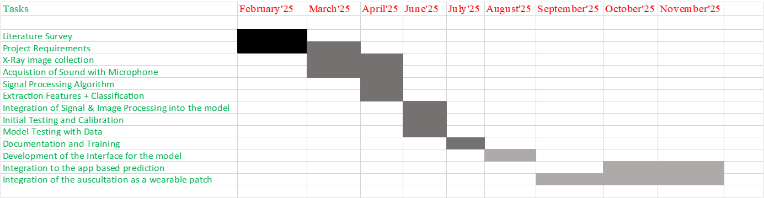
Gantt Chart

Slide 17
Literature Survey
Paper Details | Objective of paper, Techniques/Methods | Advantages | Limitations
Computer-Aided Diagnosis System for Lung Fibrosis: From the Effect of Radiomic Features and Multi-Layer-Perceptron Mixers to Pre-Clinical Evaluation | High resolution CT 2D,3D x-ray Computer vision(to compare with human readings) | Comparative study btw humans and computer vision(clinical validation is performed) Highly accurate Multi-feature integration | Presence of misclassification
Lung Sound Classification With Multi-Feature Integration Utilizing Lightweight CNN Model By T. Wanasinghe; S. Bandara; S. Madusanka; D. Meedeniya; M. Bandara; I. D. L. T. DÃ­ez | Lightweight CNN model for lung sound classification using multiple audio-specific features & Mel spectrograms, MFCCs, and Chromagram features from lung sounds. | High Accuracy Multi-Feature Integration Explainability | Data Imbalance Lack of Clinical Validation Limited Generalization

Slide 18
References
https://www.pulmonaryfibrosis360.com/pcp/suspecting-pulmonary-fibrosis/act-when-you-hear-dry-inspiratory-crackles
https://pubmed.ncbi.nlm.nih.gov/29914454/
Computer-Aided Diagnosis System for Lung Fibrosis: From the Effect of Radiomic Features and Multi-Layer-Perceptron Mixers to Pre-Clinical Evaluation
https://www.mayoclinic.org/diseases-conditions/pulmonary-fibrosis/symptoms-causes/syc-20353690
https://drkalpeshpanchal.com/facts-about-pulmonary-fibrosis/
https://www.news-medical.net/health/What-is-Fibrosis.aspx
https://pmc.ncbi.nlm.nih.gov/articles/PMC9963026/
https://www.mypathologyreport.ca/pathology-dictionary/fibrosis/

Slide 19
Thank You

